Slide 1
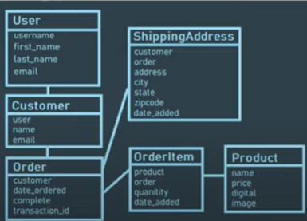
Database Summary
fdfd

